Slide 1
Analysis of Twitter Sentiment for Presidential Candidates
Final Project Presentation
W205: Storing and Retrieving DatA
Manish Sannat and Will Oldfather
August 10, 2016

Slide 2
Introduction

Slide 3

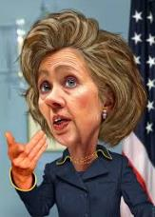
Topic Overview
2016 presidential race has been unlike any race before it
Fundamental models built on past data predict a close election
Polling data can fluctuate significantly, particularly after the National Conventions
Forecasts show Hillary building a significant lead in recent weeks; interested to see this reflected in social media data in real time

Slide 4

Social Media and Politics
More than ever, social media is intertwined with political coverage
Social media platforms like Twitter are increasingly being used as a forum for political debate and discussion
Users also express feelings toward candidates

Slide 5
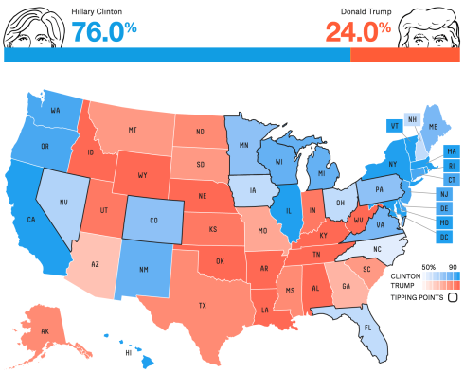
Project Goals
Use Twitter data to track what people are saying about Clinton and Trump
Analyze sentiment of relevant Tweets to explore public reaction to candidates
Map the tops words and sentiment scores across the country, and compare to established prediction models
Source: projects.fivethirtyeight.com

Slide 6
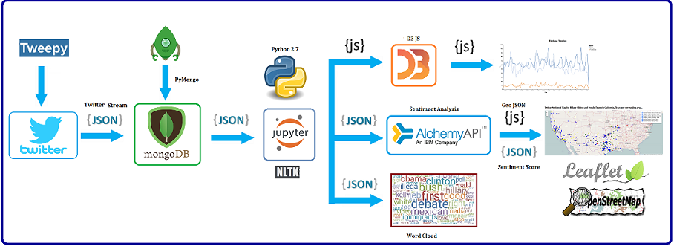
System Architecture

Slide 7
Architecture and Process Flow
Data Source
Twitter Stream
Processing
Extract: Mongo export util
Transform: Python libraries
Reporting & Visualization
D3
Leaflet
Acquisition
Storage
Python (Tweepy)
Mongo DB
JSON
Amazon AMI
Word Cloud
Pre-processing (NLTK)
Open Street Map
Sentiment Analysis
PyMongo
Stream Tweets from Twitter API using Python’s Tweepy library
Apply filters to input Tweets related to presidential candidates
Parse Tweet text into individual words and location information (when available)
Tweets stored in JSON format
Bulk transfer of raw Twitter data to Mongo DB
Housed in single EC2 instance on AWS
Use Python to explore Tweet data, including frequent terms,, hashtags, topics modelling
Apply Alchemy API for sentiment analysis
Word cloud visualization
Hashtags trends
Hashtags trends
Sentiment Map

Slide 8
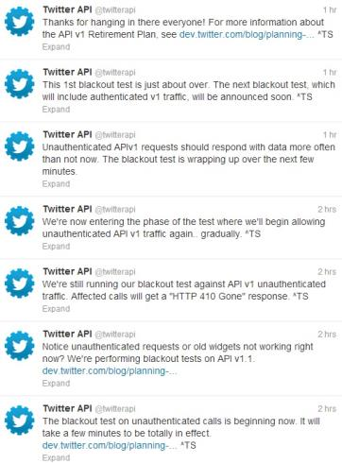
Data Source
Collect streaming Tweets from Twitter API using Python Tweepy library
Includes text and location tags in JSON format
Filter for Tweets referencing “Clinton” and “Trump”
Parse Tweet text into individual words
Remove stop words, special characters, emojis and format URLs, numbers etc.
Collected Twitter feed for ~300mins, accumulating ~400k unique Tweets

Slide 9


Data Storage
Used MongoDB for persistence data storage on Amazon EC2 instance
Extracted Tweet data stored as JSON file for analysis
Collected total of [TBU] Tweets for a volume of ~2-3 GB
Interact with MongoDB using pymongo library
Batch transfer of streamed Tweets; JSON format
~2-3 GB

Slide 10
Project Results
Implemented Twitter Stream filtered with track and location of tweets and stored into Mongo DB.
Examined tweets for topics, terms and hashtags and visualized results using D3.js, Word Cloud and Open Street Map.
Analyzed sentiment of relevant Tweets to explore public reaction to candidates in CA and TX and found opinions expressed not reflective of electoral votes of the respective states.

Slide 11
Trending Analysis I – Topic Modeling
Collected most frequent terms, hashtags, pairs of words occurring together.
Search for frequency of certain terms/hashtags (e.g. “nevertrump”, “#maga”, “#imwithher”, etc.)
Output charts using D3

Slide 12
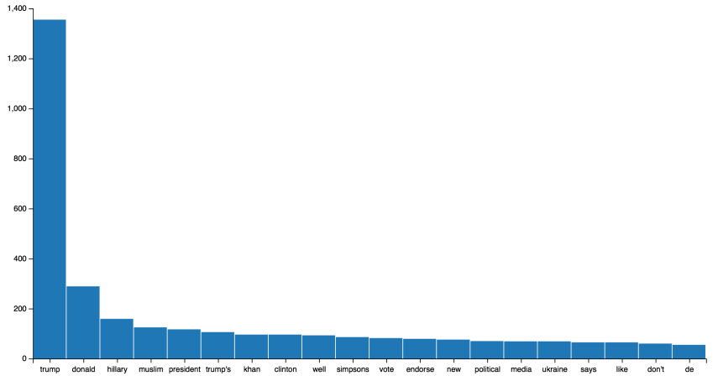
Trending Analysis I – Topic Modeling
Charts Here

Slide 13
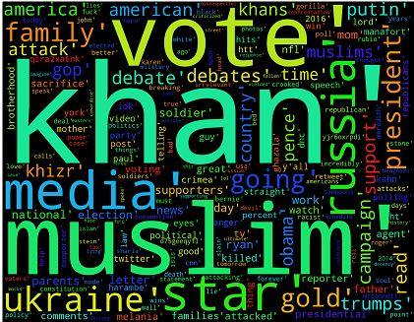
Trending Analysis II – Word Cloud
Create word clouds of common terms for each candidate using Python WordCloud package
Charts Here

Slide 14
Trending Analysis III – Time Series
Distribution of hashtags over time.
To understand Twitter users reaction to real-time events/ incidents.
Overlapped multiple hashtags to see which topics get more attention.

Slide 15
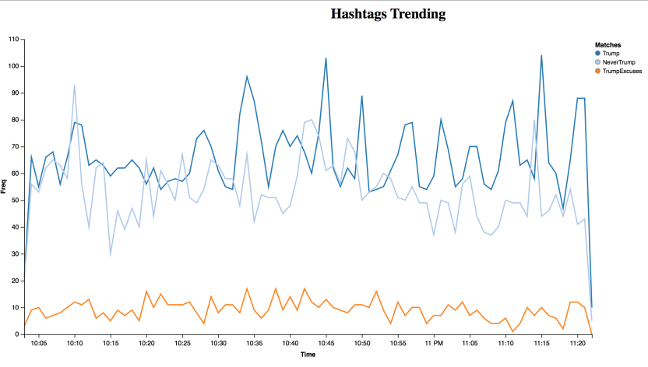
Trending Analysis III – Time Series
Charts Here

Slide 16
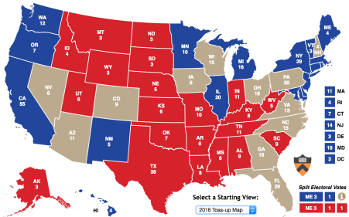
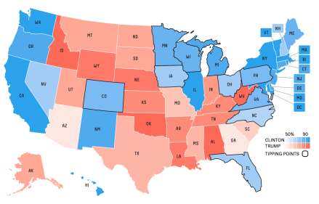
Sentiment Analysis
Want to see if social media sentiment mirrors the polling data and predictions we see thus far
Use IBM Alchemy API to perform sentiment analysis on Tweets from specific locations

Slide 17
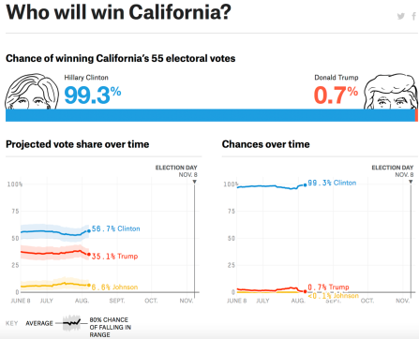
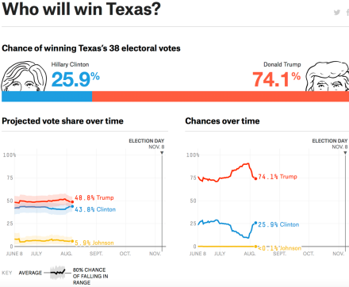
Sentiment Analysis
Selected California, where Hillary dominates…
…and Texas, where Trump is ahead, as test cases.

Slide 18
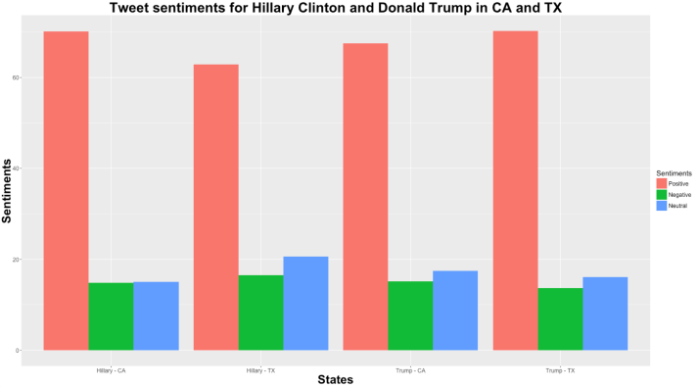
Sentiment Analysis
Our findings show…Twitter sentiment is not reflective of electoral votes.

Slide 19
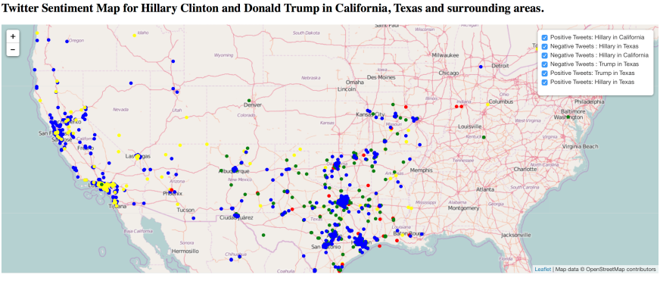
Sentiment Analysis– Map
For Tweets with geotagged information, overlay the sentiment results on a US map
Charts Here

Slide 20
Sentiment Analysis
Challenges with Sentiment Analysis
Active Twitter user base represents a small portion of electoral vote.
Tweets at any point of time are reflective of current state of affairs/ events.
Most of the tweets mentioning presidential candidates are not geo enabled.
Issues with Sentiment Analysis.

Slide 21
Conclusion

Slide 22
Project Takeaways
Project as presented limits for rate of extraction and storage on a single EC2 instance
Encountered problems with data cleaning for certain characters that persisted beyond initial filtering and parsing
Sentiment analysis has serious limitations (e.g. doesn’t differentiate sentiment value between “good” and “great”)
Not all voters are on Twitter, and results present a biased view of younger, lower income demographics
Geographic data in public Tweets was quite limited, which reduces the effectiveness of our geographic analysis

Slide 23
Future Improvements
Aggregate multiple sources of data, including other social media platforms and detailed polling data, to reduce bias and improve the meaningfulness of our results
Perform more in-depth sentiment analysis with greater amount of training data to drive deeper emotional insights from the data
Add alert mechanism to notify when positive sentiment dips or negative sentiment spikes in order to quantify and provide feedback about what issues are resonating most with social media users

Slide 24

Thank You!

